Slide 1

PRESENTATION ON
Employee Management System
B .Venkatesh
R. Jayendra
Batch: 484

Slide 2
About me
I’m Jayendra pursuing B.tech final year at Anurag University
Data Analytics:
Data analytics helps to understand this data
I want to learn data analytics to work with data and find useful Information
Linkedin:
https://www.linkedin.com/in/rapally-jayendra-91ab8329b
Github:
https://github.com/RAPALLY-JAYENDRA
I am Venkatesh and I have completed my Post Graduation in Master of Computer Applications (MCA) from Aurora’s PG College
Data Analytics:
Interested in working with data and insights
Opportunity to work with SQL, Python, and Power BI
Strong career growth and industry demand
LinkedIn:
www.linkedin.com/in/venkatesh-badiga-9766a930b
GitHub :
https://github.com/badigavenkat-alt

Slide 3
Agenda
Business Problem
Problem Statement
Objectives
ER Diagram
Queries
Conclusion
Recommendation
Q & A
Thank You

Slide 4
Business Problem
Organizations face major challenges in managing employee-related data such as personal details, job roles, salaries, qualifications, leave records, and payroll information.
Many companies still rely on manual processes or disconnected systems, which often lead to data redundancy, payroll errors, inefficient leave tracking, and difficulty in generating accurate reports.
Without a centralized Employee Management System, HR departments struggle to monitor employee performance, maintain data consistency, and make informed decisions.
These issues reduce operational efficiency and affect overall organizational productivity.
The Employee Management System aims to solve these problems by providing a structured SQL-based database solution that securely stores and manages all employee information in one centralized system.

Slide 5
Problem Statement
The organization lacks a centralized system to manage employee details, job roles, salaries, qualifications, leave records, and payroll information effectively. Existing manual processes are time-consuming and prone to errors, leading to difficulties in maintaining accurate records and generating reports. The Employee Management System is designed to provide a structured SQL-based database solution that ensures efficient data management, improves HR operations, and supports better organizational decision-making.

Slide 6
Objective
To manage employee information in a centralized database system
To track departments, job roles, and salary details efficiently
To maintain employee qualification and leave records
To simplify payroll management and reporting processes
To analyze employee and department data using SQL queries
To improve HR operations and support better decision-making

Slide 7
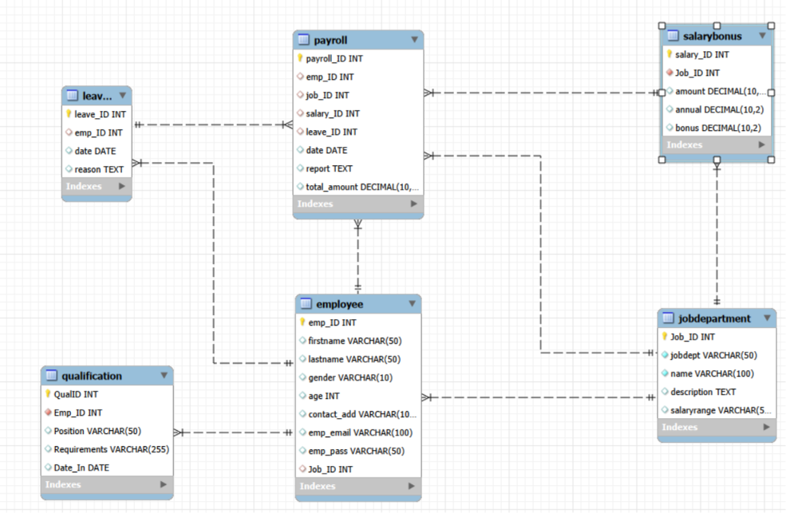
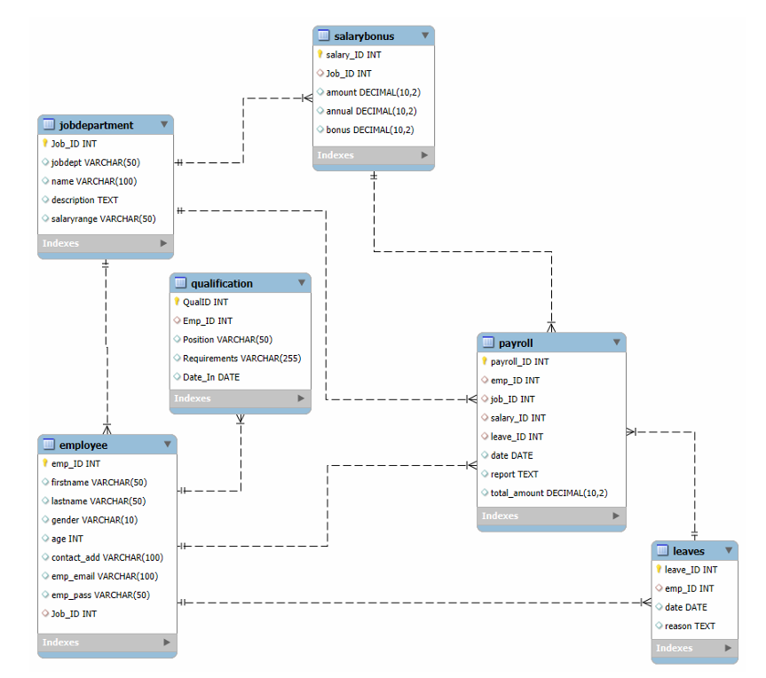
ER Diagram

Slide 8


Queries
1. Total unique employees
Key Insights:
The organization currently has 60 unique employees in the system.
Each employee record is uniquely identified using emp_ID.
This query helps HR monitor the total workforce accurately.
It also ensures there are no duplicate employee records in the database.

Slide 9
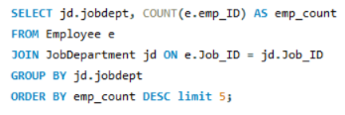
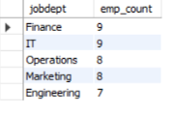
Queries
2. Departments with highest number of employees
Key Insights:
The Finance and IT departments have the highest number of employees, with 9 employees each.
The Operations department follows with 8 employees.
Engineering, Sales, and HR departments each have 7 employees.

Slide 10
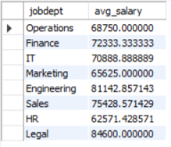
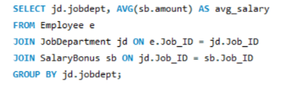
Queries
3. Average salary per department
Key Insights:
The Legal department has the highest average salary at approximately 84,600.
Engineering follows with an average salary of around 81,143.
The Sales and Finance departments also offer comparatively high average salaries.
The HR department has the lowest average salary at approximately 62,571.

Slide 11
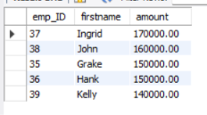
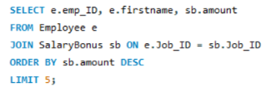
Queries
4.Top 5 highest-paid employees
Key Insights:
Ingrid is the highest-paid employee with a salary of 170,000.
John holds the second-highest salary at 160,000.
Grake and Hank both earn 150,000.
Kelly ranks fifth with a salary of 140,000.

Slide 12


Queries
5. Total salary expenditure
Key Insights:
The total salary expenditure of the organization is 4,321,000.
This represents the overall amount allocated for employee salaries.
The analysis helps management understand overall payroll expenses.

Slide 13
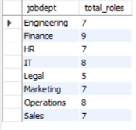

Queries
6. Number of job roles per department
Key Insights:
The Finance department has the highest number of job roles with 9 roles.
IT and Operations departments each have 8 job roles.
Engineering, HR, Marketing, and Sales departments each contain 7 roles.
The Legal department has the lowest number of job roles with 5 roles.

Slide 14
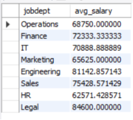
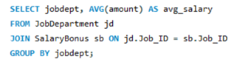
Queries
7. Average salary range per department
Key Insights:
The Legal department has the highest average salary range at approximately 84,600.
Engineering and Sales departments also have high average salary ranges.
The Finance and IT departments maintain competitive salary structures.
The HR department has the lowest average salary range at approximately 62,571.

Slide 15
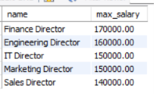
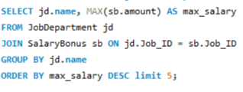
Queries
8. Job roles with highest salary
Key Insights:
The Finance Director role offers the highest salary at 170,000.
Engineering Director is the second highest-paid role with 160,000.
Marketing Director and IT Director both offer salaries of 150,000.

Slide 16
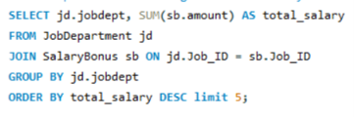
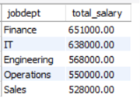
Queries
9. Departments with highest total salary allocation
Key Insights:
The Finance department has the highest total salary allocation at 651,000.
The IT department follows with a total allocation of 638,000.
Engineering and Operations departments also contribute significantly to salary expenses.
The Legal department has the lowest total salary allocation at 423,000.

Slide 17


Queries
10. Employees with at least one qualification
Key Insights:
All 60 employees in the organization have at least one qualification recorded.
This indicates that the workforce is fully qualified for their respective job roles.
The organization maintains proper qualification records for all employees.

Slide 18
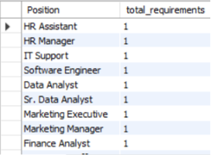

Queries
11. Positions requiring most qualifications
Key Insights:
All listed job positions currently have one qualification requirement each.
Positions such as HR Manager, Software Engineer, Data Analyst, and Marketing Manager require specific qualifications.
The organization maintains qualification standards across different job roles.

Slide 19
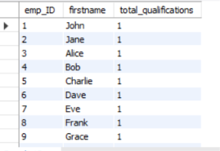
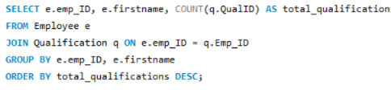
Queries
12. Employees with highest number of qualifications
Key Insights:
Employees such as John, Jane, Alice, Bob, and Charlie each have one qualification recorded.
All listed employees currently have an equal number of qualifications.
The organization maintains qualification records consistently across employees.

Slide 20
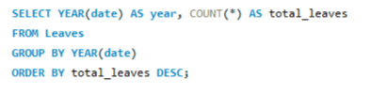

Queries
13. Year with most leaves
Key Insights:
The year 2024 recorded the highest number of employee leaves with 60 leave entries.
This indicates increased leave activity during the year.
The analysis helps HR monitor employee absence trends over time.

Slide 21
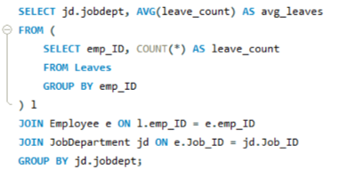
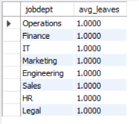
Queries
14. Average leaves per department
Key Insights:
All departments have an average leave count of 1 leave per employee.
Leave distribution is consistent across all departments.
No department shows unusually high or low leave activity.

Slide 22
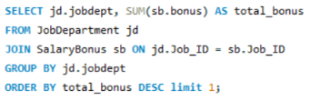

Queries
15. Department with highest bonuses.
Key Insights:
The Finance department receives the highest total bonus amount at 96,000.
The IT department follows closely with 94,000 in bonuses.
Engineering and Sales departments also receive high bonus allocations.
The HR department has the lowest total bonus amount at 57,200.

Slide 23
CONCLUSION
The Employee Management System helps manage employee data efficiently using SQL.
It centralizes information related to employees, departments, salaries, and payroll.
The system improves accuracy and reduces manual data management errors.
SQL analysis provides useful insights for HR and management decisions.
Leave tracking and payroll processing become easier and more organized.
Overall, the project supports better operational efficiency and data management.

Slide 24
Recommendations
Implement an automated payroll management system to reduce manual errors.
Maintain accurate and updated employee records regularly.
Use employee performance and leave analysis for better HR planning.
Improve data security for employee login and personal information.
Generate regular reports to support management decision-making.
Integrate dashboards and visualization tools for better data analysis.
Ensure proper backup and maintenance of the database system.

Slide 25

Q & A

Slide 26

THANK YOU

